Slide 1
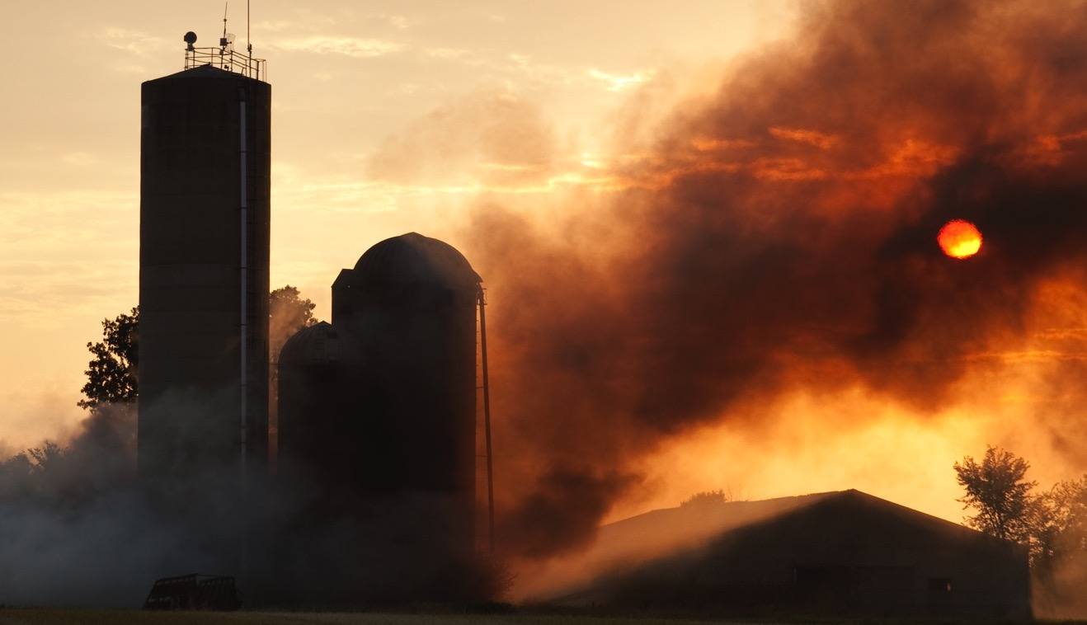
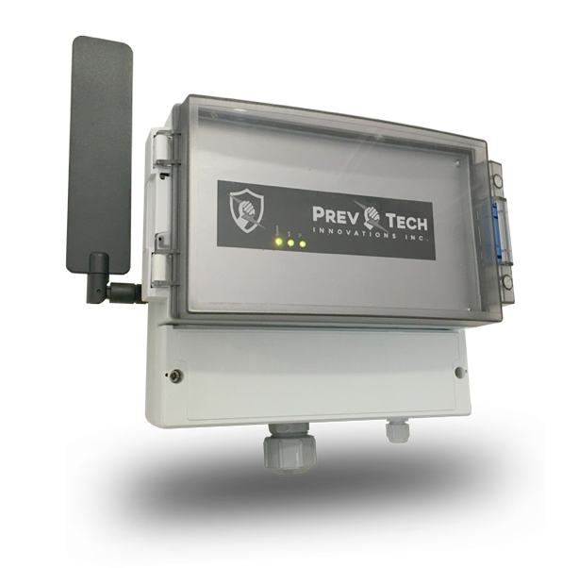
Reducing the Risk of Fire
in Farm Operations

Slide 2
What is PrevTech ?
OUR MISSION
- Reduce the risk of fire in farm operations
- Optimize operational efficiency by reducing unplanned equipment downtime
- More than 40% of farm fire are caused by electrical problems
- A healthy electrical network is a safe network
- Peace of mind to producers
- Electrical network surveillance services
- Technical support included
- Troubleshooting assistance and identification of required preventive measures
- Simple installation at the main electrical service of the farm
- Monitors up to 6 individual panels
- Multiple temperature sensors
WHY ?
WHAT WE BELIEVE IN
WHAT WE DELIVER
SERVICE FIRST
PREVTECH UNIT

Slide 3
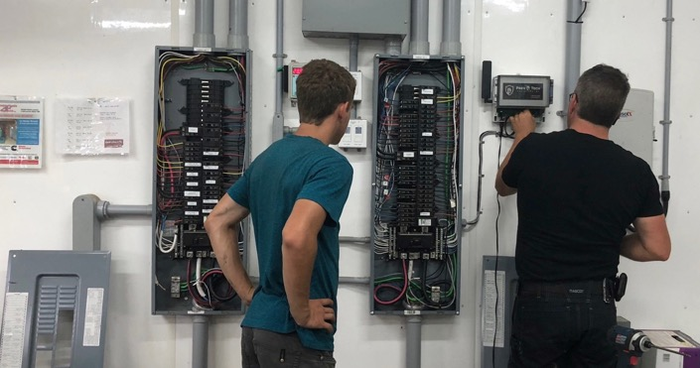
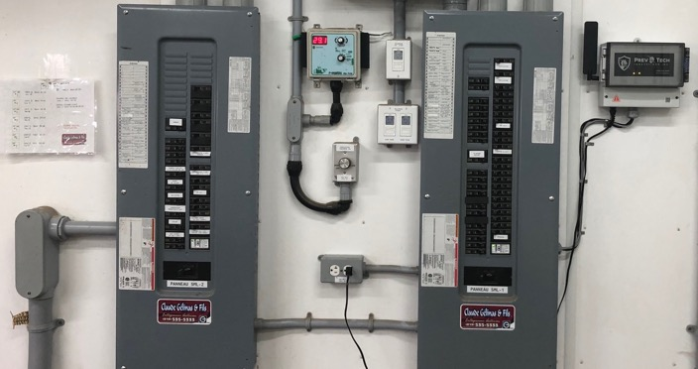


SOLUTION
Simple, Robust & Reliable
PrevTech Unit

Slide 4

SOLUTION
Surveillance 24 / 7
Step 1
- Simple and fast install (approx. 2hrs)
- Non-invasive, Autonomous
- No configuration required
- Independent wireless and secure communication
Step 2 Continuous
Surveillance from Day 1
Step 3
Detection:
Anomalies and faults
Degradations
Overheating
Step 4
Communication:
SMS to client and his assigned electrician

Slide 5


At Your Service
PREVENTION
Customer support and active monitoring
Active alarm management with assisted Artificial Intelligence
Direct support to licensed electrician towards corrective solutions
Yearly site visit to ensure installation quality and conformity

Slide 6


Simple User Interface
TECHNOLOGY
Visual representation of your operations making it easy to identify problems
Illustrated case: Faulty sentinel lighting and a mixer motor showing early signs of a pending failure.
Real time temperature monitoring of the electrical panels and other components
Notification of power outages
On PC or Mac
& Mobile

Slide 7
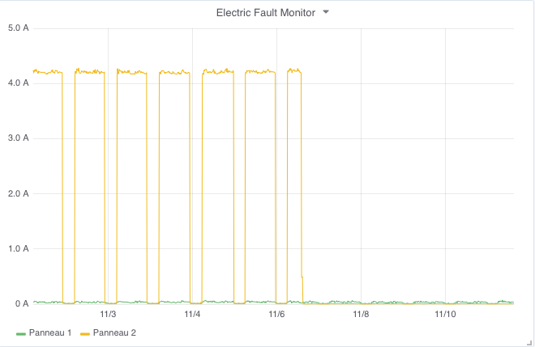
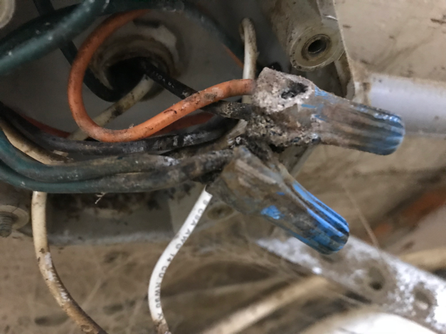
Client Case
DATA
Clear fault pattern
Before
Problem Found
After
What was found: A junction box with excessive moisture and worn-out connections
PREVTECH
ALARM

Slide 8
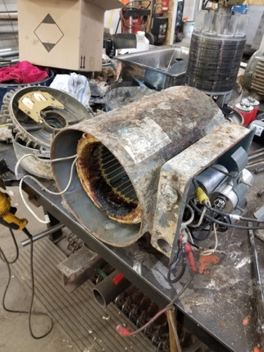
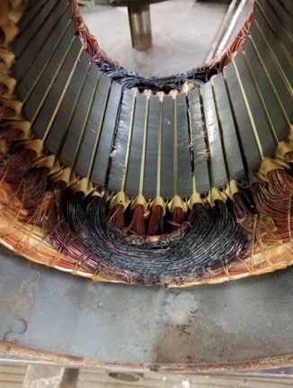
Client Case
DATA
1st alarm immediately received after motor start-up
Addition tests to asses the severity and motor working condition
What was found: A burn-out large motor which got caught promptly

Slide 9
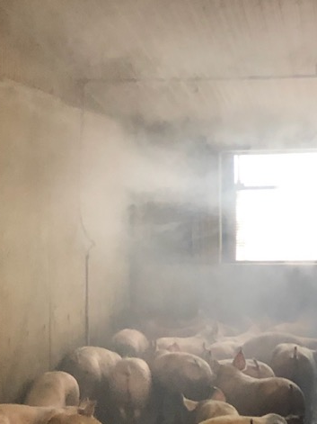
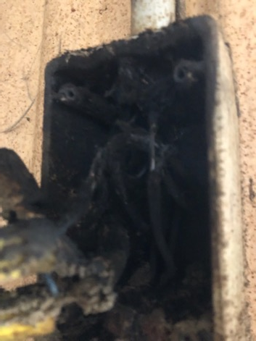
DATA
Client Case
Corrective
Measure Applied
What was found: After a pressure wash job, some water ran down the PVC tubing into a junction box creating an important fault in the box. Prompted by the SMS, there was a quick reaction from the client and PrevTech.
Important
Fault
Fault
Identified
Important and hazardous case

Slide 10
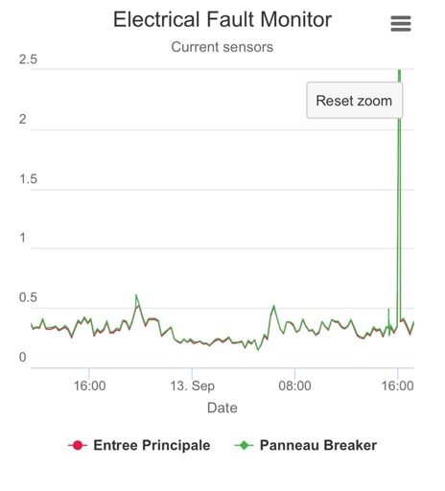
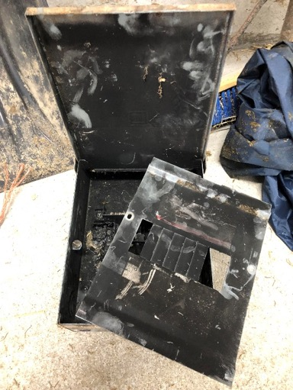
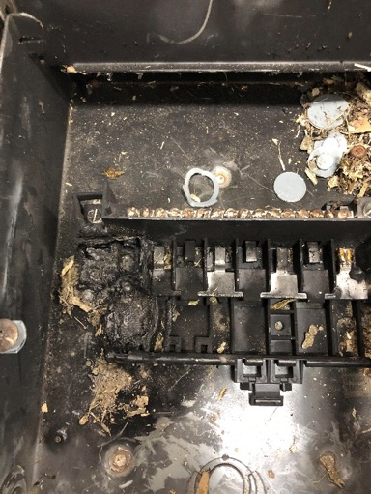
DATA
Client Case
What was found: Client’s reaction to the notification had him go to the barn and notice the smell and close the load
Fault

Slide 11
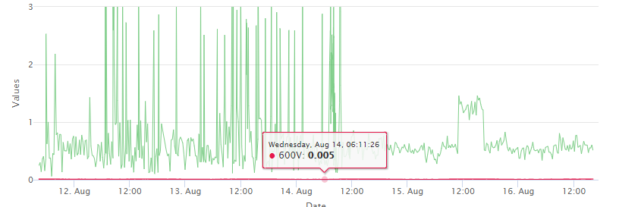
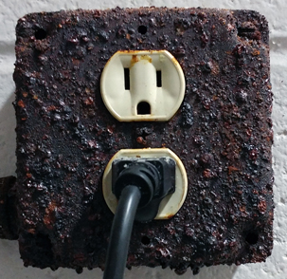
DATA
Client Case
Severe fault detected
What was found: A faulty and severely corroded outlet used for a water pump suppling water to multiple weaner barns
After corrective measures

Slide 12
DATA
What was found: Sudden failure of a mixer motor contactor. Quick response from the client as soon as the SMS was received.
Client Case
PREVTECH
ALARM

Slide 13
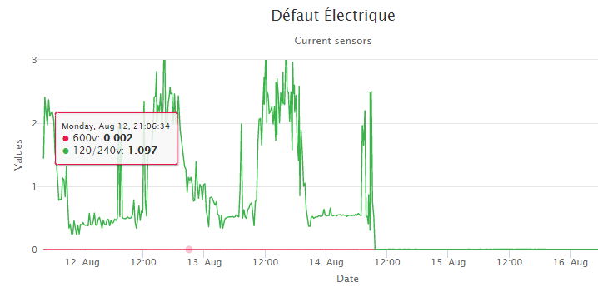
DATA
Client Case
What was found: Multiple electrical nonconformities, faulty cabling practices and compromised lighting fixture.
Important hazardous case
Before
After
PREVTECH
ALARM

Slide 14
DATA
Client Case
What was found: A broken connector and electrical terminals on a cow brush
(2.5A+ current leakage) !!!
PREVTECH
ALARM

Slide 15
Powerful Realtime Diagnostic Tool
DIAGNOSTIC
How de we support and help our clients and troubleshoot their problems ?
With our :
Remote or onsite (on mobile)
Non invasive,
Always on,
High precision,
diagnostic engine, tools and methodology
Available to the client’s licensed electrician and PrevTech technical staff

Slide 16
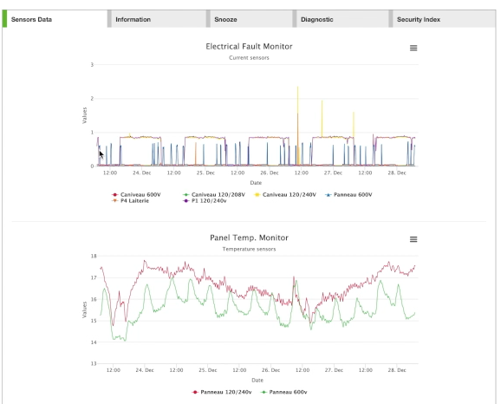
Realtime Diagnostic - Demo
DIAGNOSTIC
SKILLS and EXPERTISE
at your service to help !
We believe that our clients need to be guided and supported through the process of upkeeping their electrical network.
With PrevTech’s support included in our service offering, we can efficiently assist our clients identify the problem’s source and guide them towards their next steps.

Slide 17
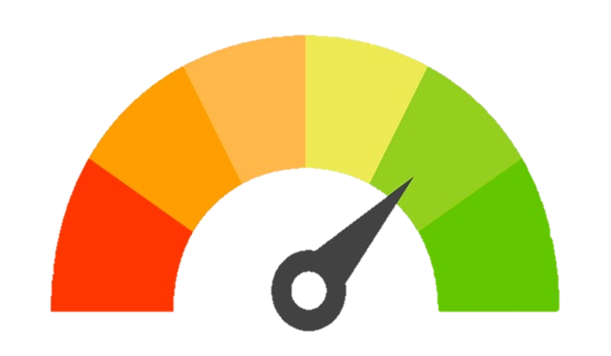
INDEX
PrevTech Electrical Safety Index©
PrevTech Electrical
Safety Index©
A - Excellent
B - Good Quality Network
C – Requires Attention
Z – Sentinel Zone
D – At Risk -Regular Alarms
Intervention Required
C
B
Z
A
D
Not all farms and electrical networks are the same
A simple and effective tool to assess and manage risk
Available on each PrevTech Unit dashboard

Slide 18
PRICE
Tailored Solution for Agriculture
More than one PrevTech unit required ?
1 to 10 units = Aggressive volume pricing structure
10+ units = Custom project pricing
Technology
Designed & Adapted for Agriculture $1,675*
$995 / year*
Simple and fast
Approx. 1 year
Included
5 years
Price
Monitoring & Service
Installation
Client ROI
Yearly Conformity Visit
Product Warranty
*First main electrical service
Site price with multiple services available

Slide 19
Recognized
RECOGNIZED
Recognized by Most Insurance Companies
Client must communicate with their broker, agent or advisor to get informed on potential incentives that may be applicable.

Slide 20
Summary : Key Attributes
SUMMARY
Peace of Mind, Prevention & Protection
Reduce the risk of fire at the farm
Reduce unexpected and costly operation downtime
(faulty well pump, failing vacuum pump, feeder motor,…)
Fast return on investment
Productivity gains : a single avoided failure can make up for the cost of the solution
Applicable incentives provided by participating insurers

Slide 21
TESTIMONIALS
Our clients are sharing (1/3)
« With all the time, energy and money that we put into our businesses, nothing can be left to chance. Prevention is at the heart of our strategies, the tools and solutions brought by PrevTech are exactly what we need at home. »
Dominic Drapeau - Ferme Drapeau et Bélanger Inc.
« Their service is great! They are always available to answer our questions. We feel safe with their monitoring of our network, especially when we are not there. »
Roch Hébert - Rotaly Farm
« The installation of the PrevTeh system on the farm, in addition to being an essential asset for fire prevention, makes it possible to detect minor anomalies on electrical equipment and to intervene before a breakdown occurs. »
Sébastien Hudon - Jeandon Farm
« PrevTech allowed us to quickly identify an electrical fault on a cow brush. We were able to correct a situation that could not have been detected otherwise. We were able to make the fixes before it caused any problems.»
Ghislain Beauchemin - JN Beauchemin Farm, St-Ours

Slide 22
TESTIMONIALS
Our clients are sharing (2/3)
"With PrevTech, we are aware of the importance of a healthy electricity system on our farm. It helps us to take preventative actions and reduce the risk of interruption of operation. "
Jean-Michel Lachance - Farm NJM Lachance
"PrevTech allows us to track our customers and assist them quickly in case of problems on their network. An important asset for prevention for agricultural producers”
François Martineau - Les Installations Électriques R. Théberge
"We have so much electrical equipment on the farm and we need more and more power to run our operations. With all the hard work, it's hard to keep an eye on the electrical components. PrevTech does it for us. "
Pascal Lacoste – Farm Cougar
"All our customers should install a PrevTech unit. With this technological innovation, we can better serve our customers and receive fault notices before it's too late. It is a very useful diagnostic tool in the event of an electrical problem. "
RCA Serurity – Patrick Dussault

Slide 23
TESTIMONIALS
Our clients are sharing (3/3)
«One of our electrical panels was overheating without us knowing. By adding some adequate ventilation and replace a few faulty breakers things were back to normal. A dairy farm fire is devastating; we’ve been through it. PrevTech is the solution to reduce the risk of electrical fire»
Pascal Richard – Farm Lion Blanc
"PrevTech! It's peace of mind. In our operations, our electrical network must be efficient and secure. This is the PrevTech promise. "
Serge Bournival - Ferme Rouval
“Receiving a text message to inform me that I lost power in the barn allowed me to start the generator without delay.”
Benoit Masson - Ferme LIRAMO
“PrevTech allowed us to quickly identify and correct a critical situation developing with one of our motors”
Maxime Lauzon - Ferme Ferland
"The installation was quick and easy as I had been told"
Raymond Fortin – J.R. Fortin Électrique (Ferme SERIC)

Slide 24

APPENDIX
Installation Examples

Slide 25
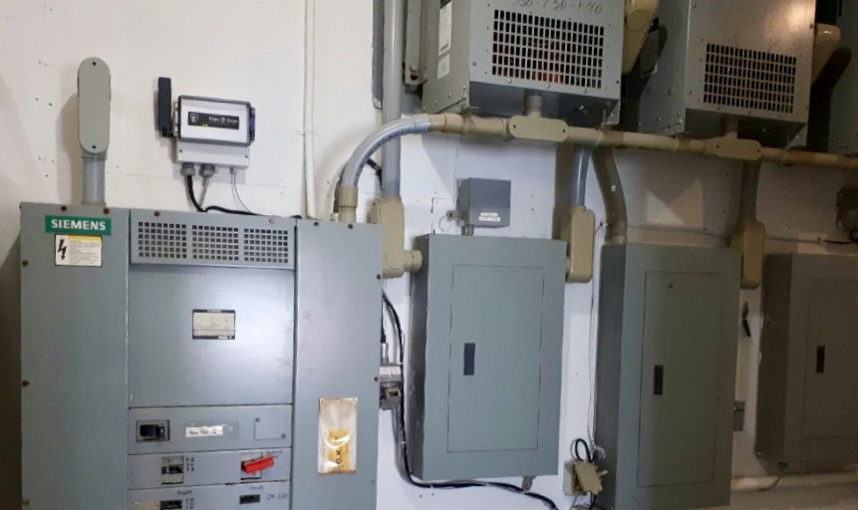
PrevTech Unit
Autonomous
None invasive

Slide 26
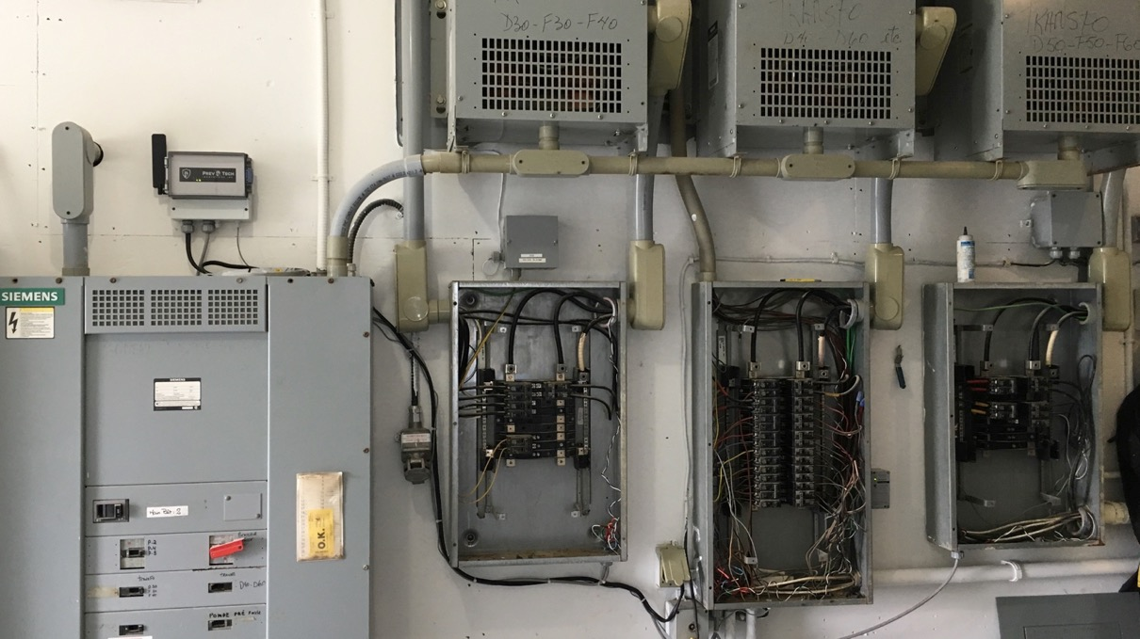
PrevTech Unit
Proprietary signal processing
Split cloud and edge A.I. and Analytics
Independent wireless communication
Sensors

Slide 27
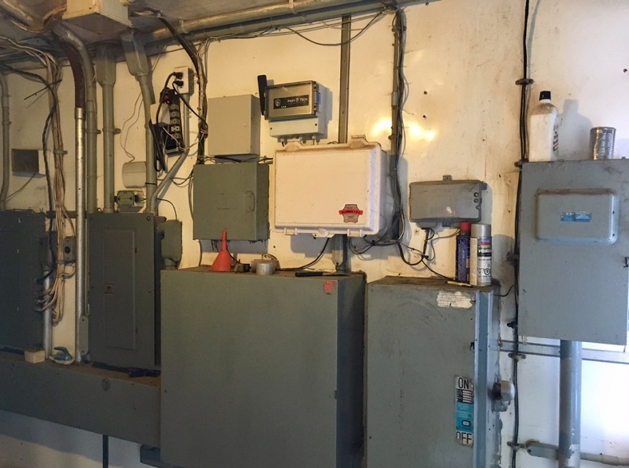
PrevTech Unit

Slide 28
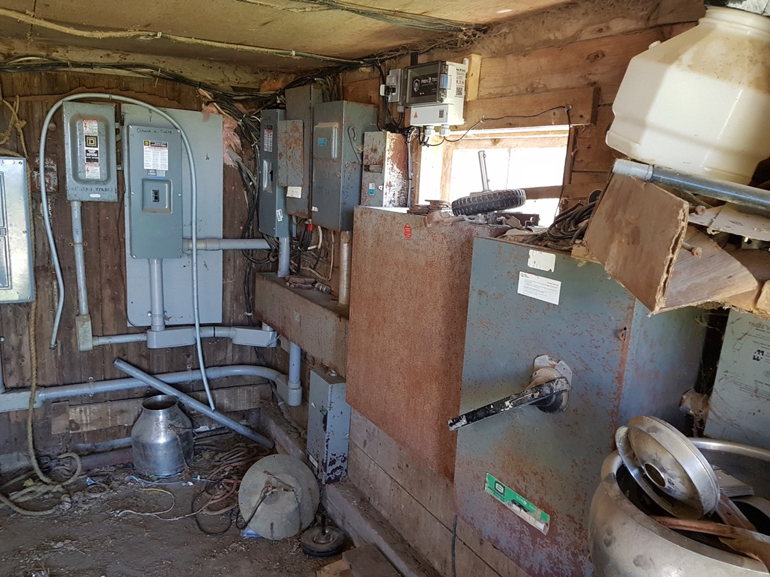
PrevTech Unit

Slide 29
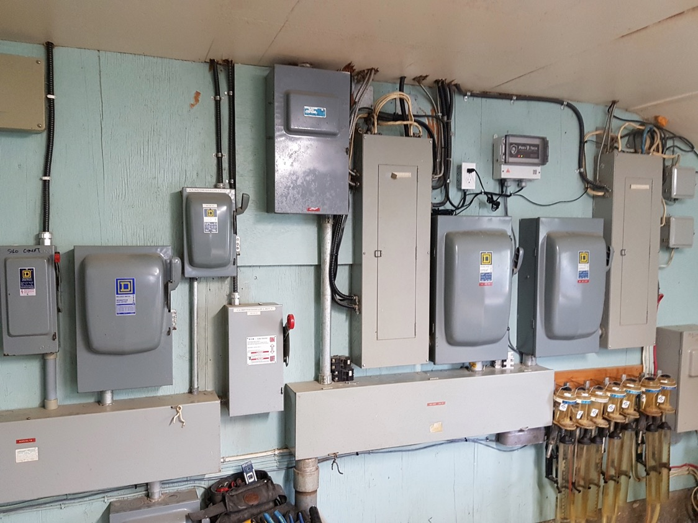
PrevTech Unit

Slide 30
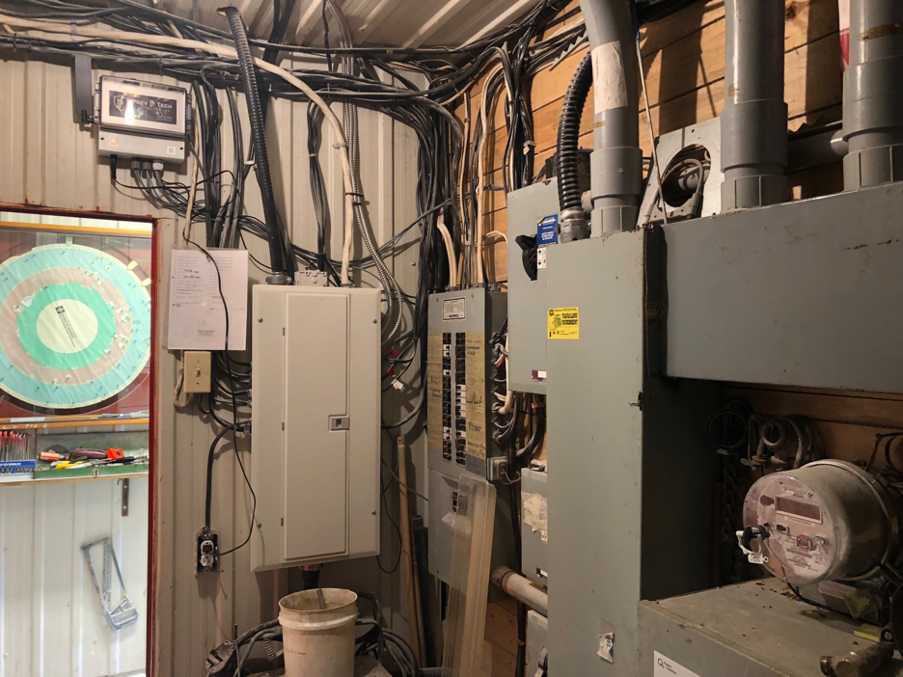
PrevTech Unit

Slide 31
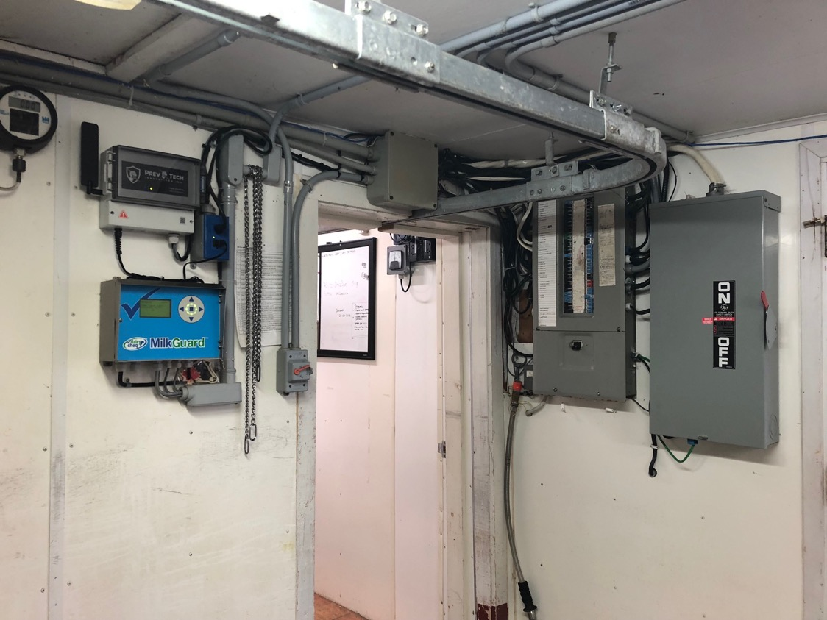
PrevTech Unit

Slide 32
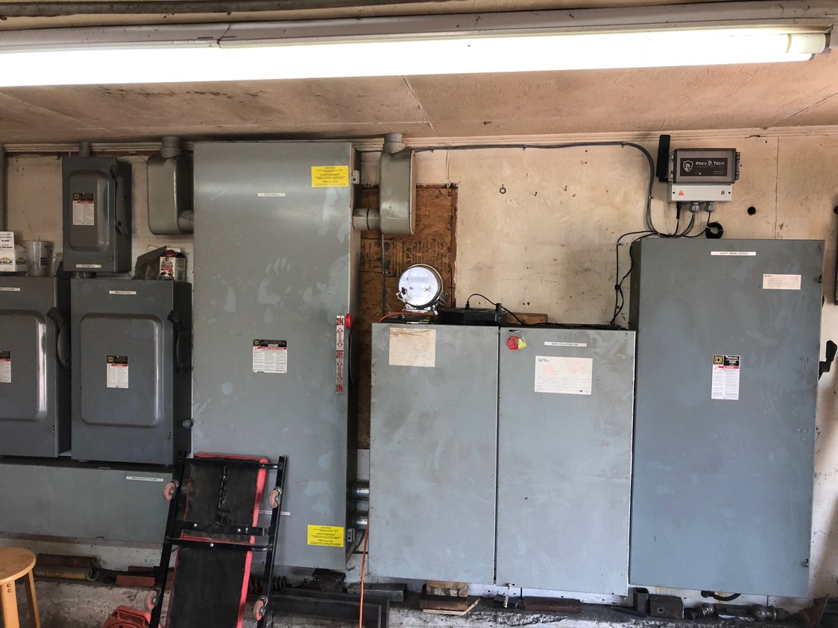
PrevTech Unit

Slide 33
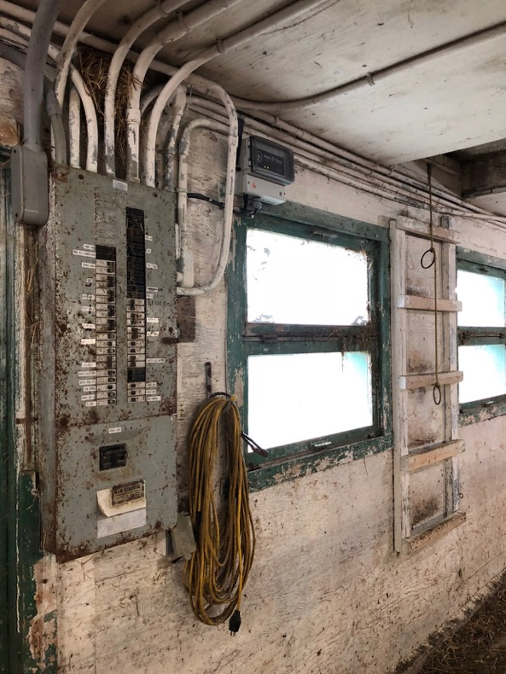
PrevTech Unit

Slide 34
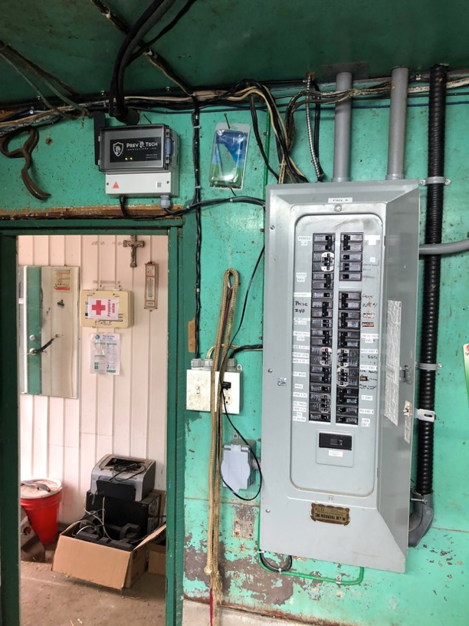
PrevTech Unit

Slide 35
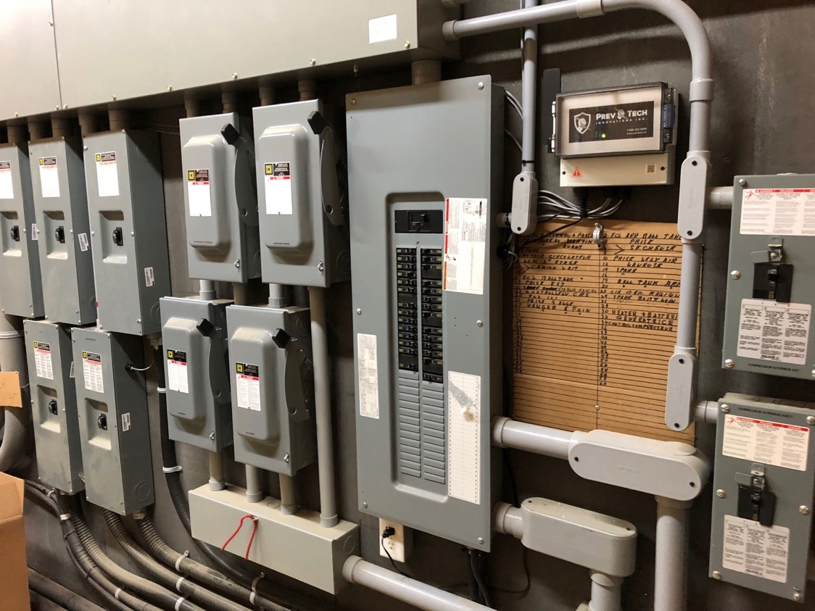
PrevTech Unit

Slide 36
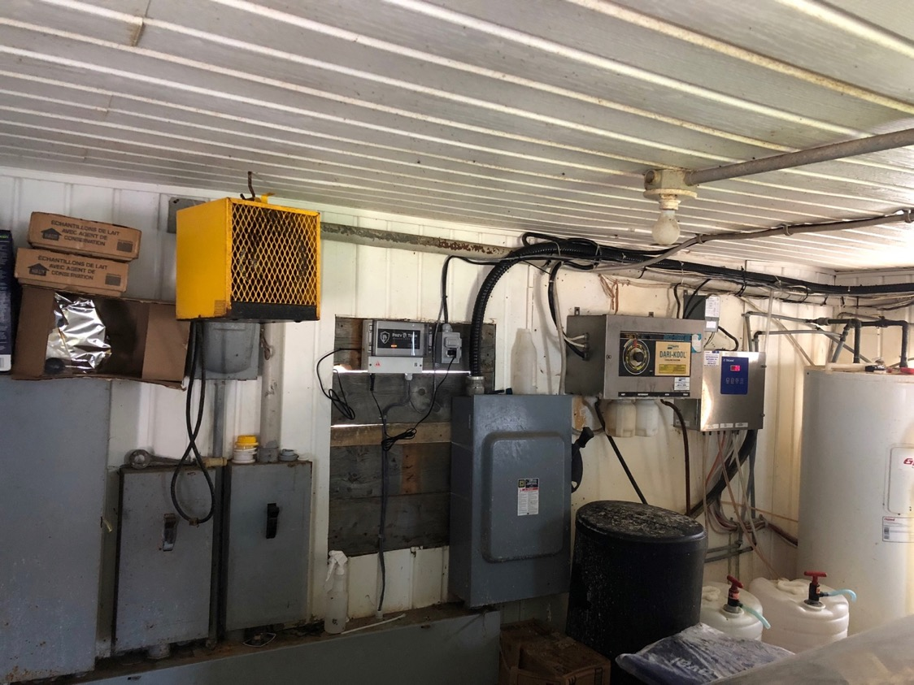
PrevTech Unit

